Slide 1
DETECT TAILGATING AND ALERT SECURITY
Hackathon

Slide 2
PROBLEM STATEMENT
Given a CCTV camera footage of a security door entry, detect anyone tailgating(entering without authorization).You should segment individuals entering building from the video and detect weather they are tailgating or not.
Given video clips and a spreadsheet that consists of card swipe information.

Slide 3
IDEA ABSTRACT
The idea is to use Machine Learning Vision and exploit OpenCV to tackle the problem of TAILGATING. Following the resources-> CCTV video clips and a spreadsheet that has access card swipe information about the person entering.
The idea is to sort the spreadsheet based on the time of the swipe and then process the video part-wise for every time interval between two consecutive sorted time instants. The video processing is done by fixing a surveillance area that is the area of interest, this is the area where detection and segmentation take place, and a rectangle is drawn surrounding the detected object(human). After the detection, identifying tailgating comes into the picture.
First of all, a count variable is initialized to 0 and whenever a rectangle's centroid passes through a set line, the count is increased by 1. If the value of count variable after each swipe of a valid card remains 1 until a new swipe, tailgating does not happen. For a valid card swipe, if the count’s value is more than 1, tailgating is said to happen. On other hand, tailgating will also occur if more than one rectangles are detected over the surveillance area at a particular time. Also, if the area of the rectangle is more than a particular threshold value (defined), it will be a case of tailgating too. Whenever tailgating occurs, an alarm is raised to alert guards.

Slide 4

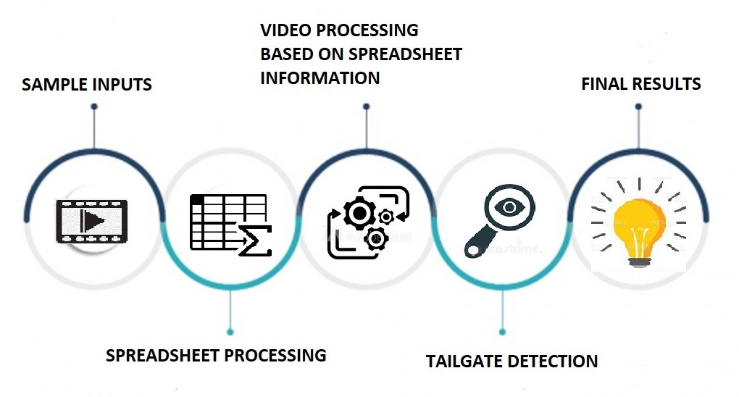
SOLUTION SUMMARY

Slide 5
SOLUTION AND IDEA DETAILS:
System Frame Work.
Spreadsheet Processing.
Image and Video Processing.
Tailgating Detection.

Slide 6
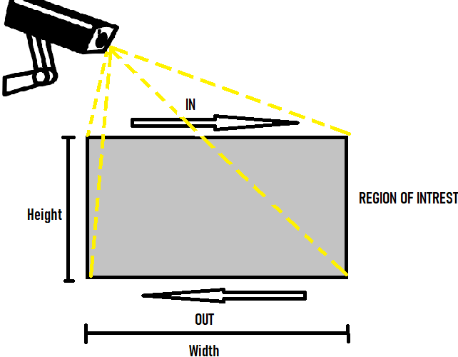
SYSTEM FRAMEWORK
Set-up - An application framework as a rectangular
compartment (similar to the one used for security check)
with a camera installed at it’s top can be used for the set up.
The height of the camera can vary depending on its capability
to cover the entire area of interest.
Video Clips –
1. Processing of the video clips (with the top views) for object detection and segmentation purpose is described in the Video Processing part.
2. If the video clips with the front views will be provided, detection and segmentation will follow the same procedure as mentioned in the video processing part.

Slide 7
SPREADSHEET PROCESSING
>> Given is a spreadsheet with the card swipe information, which includes the time of swipe, employment id, authorization result, valid card report.
Considering that the spreadsheet has a shuffled data irrespective of time, the spreadsheet will be sorted according to the ‘time of swipe’ column. This will enable us to process the video in the intervals between every two consecutive time instants of the column, and check for tailgating in the case when more than one person enters after a single card swipe.
Now moving to the Authorization result column, if a person with an invalid card tries to enter, it will be immediately marked as a tailgating condition and an alarm will be raised.

Slide 8
IMAGE AND VIDEO PROCESSING
Part A - Using Open Source Computer Vision Library:
Feeding Inputs – To provide image inputs to the machine, OpenCV functions- cv2.VideoCapture() followed by ret, frames = cap.read( ) are used, which extract the frames from the video for further processing.
Human Detection and Segmentation -For detection, the system concatenates the background by taking the first frame into the feed. Based on algorithm complexity, the Advance Background models can be used too. Once the frames are extracted, two consecutive frames retrieving the background subtractor by subtracting those frames will enable us to extract the moving object. Background subtraction is very sensitive towards the illumination change. Hence, further processing is required to remove the excess noise from the video. This can be done by using the gaussian blur as- cv2.GaussianBlur(src, ksize, sigmaX), where ‘src’ is matrix representation of the frame, ‘ksize’ is size of the kernel (greater the kernel size, lesser is the noise), and sigmaX is the kernel deviation in X direction. The connected component analysis is required to clean up the image and identify the connected region of segmented objects. So first of all, the dilation is done using cv2.dilate(src, dst, kernel). For the morphological operation, we consider an ellipse-shaped kernel. After that, we perform morphological opening i.e., erosion followed by dilation, and then morphological closing i.e., dilation followed by erosion to merge the area of nearby surviving component.

Slide 9
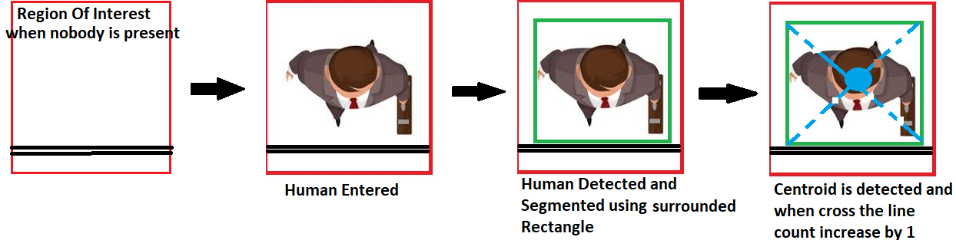
IMAGE AND VIDEO PROCESSING
Drawing contours – The processing described above will give the desired detected human. Now for segmenting it in the video, a rectangular shape can be drawn around the detected human and in the region of interest to segment, we find the largest contour that has an area greater than the threshold contour area. The threshold area is defined as Th = (FH +FW) / S , where FH is frame height, FW is frame width and S is measuring scale. Area of rectangle should be lesser than the area of interest.
Centroid of the detected human - For the tailgating detection and human counting, we draw the centroid of the detected rectangle exactly above the forehead, and assume that it represents the human. Now once the centroid crosses a specified region (a line), the count of human is incremented by 1.

Slide 10
IMAGE AND VIDEO PROCESSING
Part B – Using Pre-Trained Models:
● Apart from using OpenCV for building the detection module from scratch, we can also use some of the pre-trained models under the computer vision library often used for object detection like purposes.
● Google Mobilenet SSD and YOLOv3 are some of the best models that work well when it comes to implementing object detection algorithms.
NOTE:- Considering a broader context, both the techniques can be used in the detection and segmentation for a given video. Both the techniques can be proficiently applied and choice of the technique is done on the basis of the input video clips provided and the final results obtained.

Slide 11
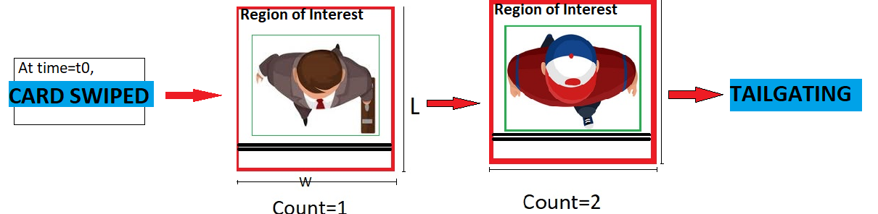
TAILGATING DETECTION
Stage 1 : People Count
◦ At every edge of time, the counting is done between the two consecutive sorted time instants collected from the spreadsheet (if the validity status of the card is valid).
◦ The reference line is drawn at the entering end by using the cv2.line() function and whenever the centroid of the rectangular contour crosses the line, the count gets increased by 1.
◦ If in between the 1st and the 2nd valid card swipe time, the count is increased for more than once, it will be considered as the tailgating condition and an alarm will be raised.

Slide 12
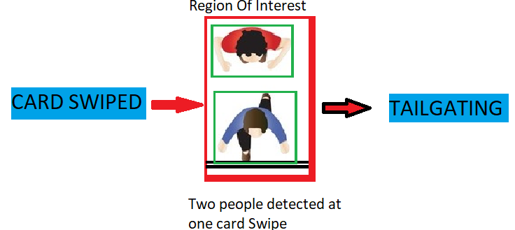
TAILGATING DETECTION
Stage2 : Contour Counting
Let the area of interest is "A". Consider the situation where at a particular time in a video, more than one contours are detected over the region/area of interest.
This can be observed by looking at the rectangles’ centroids. If two centroids are present at the same time in the region of interest, the contour count will increase for more than one time (i.e., >1) and it will lead to tailgating (alarm raised).

Slide 13
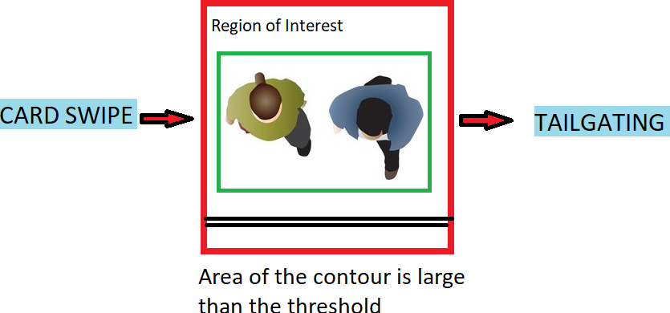
TAILGATING DETECTION
Stage 3 : Contour Area/Shape Check
A maximum or threshold value for each contour is set, let's call it "A_max“. (The area of interest is "A“).
If area of the detected rectangular contour is larger than A_max, it is possible that two people are crossing at the same time using the same authorization. Hence, it will be considered as tailgating too.

Slide 14

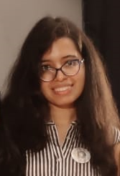
TEAM
HARSH
RAJ
B.Tech -Electronics and Electrical
Engineering
Institute – Indian Institute of
Technology, Guwahati
Skills Acquired – Machine Learning, Deep Learning, Python, OpenCV, TensorFlow, Keras, scikit-learn.
Email/Phone No. – harshraj@iitg.ac.in
DARSHANA
THAKUR
B.Tech – Electronics and Electrical
Engineering
Institute - Indian Institute of
Technology, Guwahati
Skills Acquired – Machine Learning, Deep Learning, Python, OpenCV, TensorFlow, Keras, scikit-learn
Email/Phone No. – dthakur@iitg.ac.in

Slide 15

.

